Slide 1

Course Registration System
Jedi-07 Group 3

Slide 2
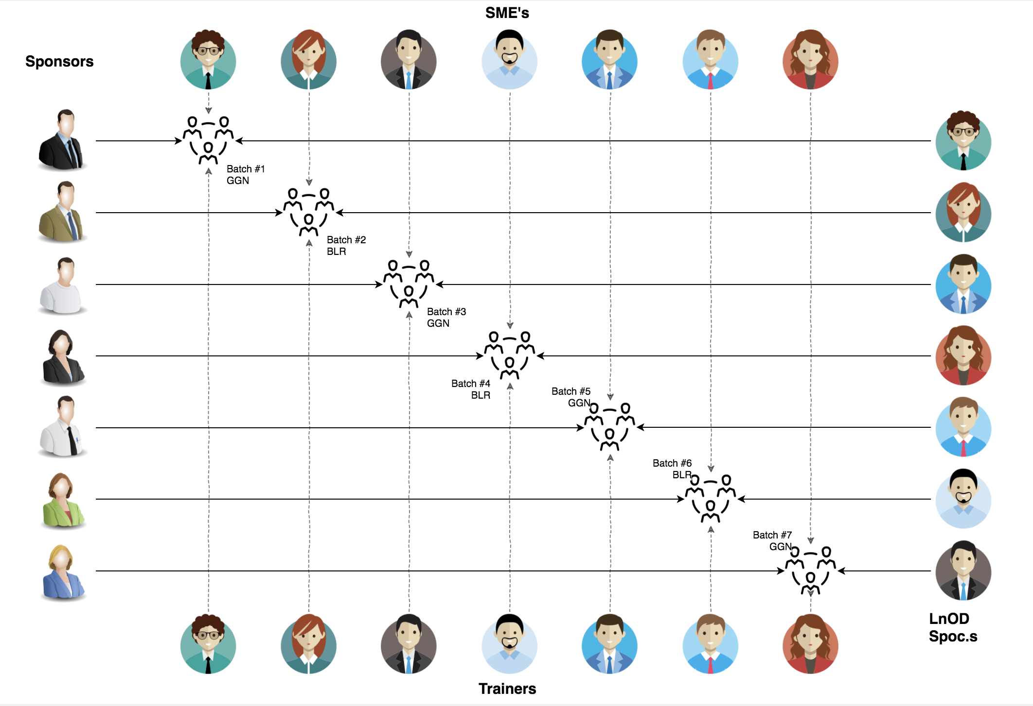
Stakeholders
Sponsors
Flipkart
Trainer
Amit Balyan
Organizers
Deepika Gajraj
Sakshi (Order Trainings)

Slide 3

Agenda
01
Our Team
02
Our Journey
03
Team Structure
04
Project Goals
05
Engineering Practices
06
Tech Stack
07
Development
08
Challenges & Learnings
09
Demo
10
Questions

Slide 4

Meet the Team!

Slide 5






Abhinav Saxena
Ashutosh Rathi
Nimisha Gupta
Sarthak Sadh
Pulkit Khurana
Srijan Setu

Slide 6
NAME | RESPONSIBILITY
ABHINAV SAXENA ASHUTOSH RATHI | Implemented Professor functionalities, User functionalities, Use Case Diagram, Class Diagram
NIMISHA GUPTA PULKIT KHURANA | Implemented Student functionalities, User functionalities, Activity Diagram, Class Diagram
SARTHAK SADH SRIJAN SETU | Implemented Admin functionalities, User functionalities, Sequence Diagram, Class Diagram

Slide 7

Our Journey

Slide 8
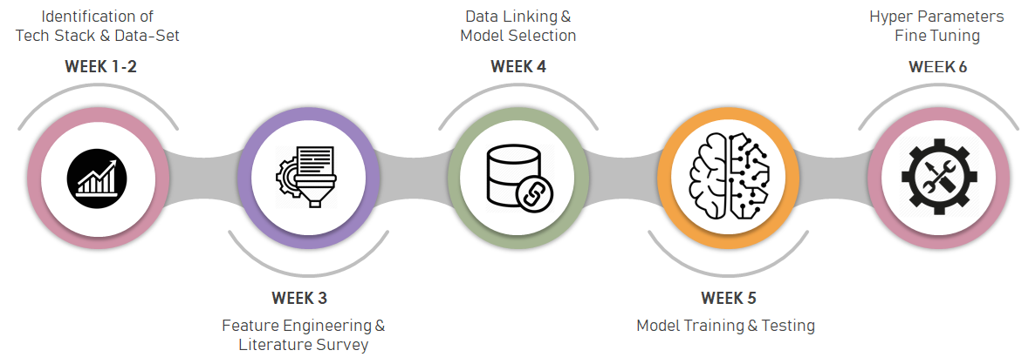
ROADMAP
Understanding about Java RESTful services & REST API development using jersey and DropWizard
Understanding basics of java and exception handling
Understanding Unix and Git Commands
1.Unix & Git
3.JAVA 8
5.REST Dropwizard
2.UML Diagrams
4.POS Application &SQL
Requirement Understanding and diagram design
Developing a POS application using Java and MySQL

Slide 9
2 WEEKS OF TRAINING + PROJECT DEMO
12 DAYS
96 HOURS
5,760 MINUTES
34,56,000 SECONDS
LIMITLESS KNOWLEDGE

Slide 10

Project Goal

Slide 11




PROBLEM STATEMENT
1
2
To develop a POS application and REST API for Course Registration System using JAVA where the student can register, add/drop course, professors can view courses, enrolled students while admin can manage users, add/drop courses to catalog
Quality
Security
3
4
Interactivity
Speed

Slide 12

Engineering Practices

Slide 13

Requirement Gathering,
risk analysis
Testing & Bug fixes
Tech Stack selection
Code Development
UML artifacts, architecture design

Slide 14
UML DIAGRAMS

Slide 15

Tech Stack

Slide 16















Designing
Backend
Testing
Data
SCM
UML
Core Language
Automation Tool
Database
Code Collaboration

Slide 17

Development

Slide 18



ARCHITECTURAL DESIGN
Java Main Client
Business Code
Database Code

Slide 19

LEARNINGS
JAVA 8
SDLC
MAVEN
DROPWIZARD
TESTING
SQL
POSTMAN
REST
LINUX COMMANDS
GIT COMMANDS
TEAM WORK
EXCEPTION HANDLING
UML DIAGRAMS

Slide 20


Slide 21


Slide 22


Slide 23


